Slide 1
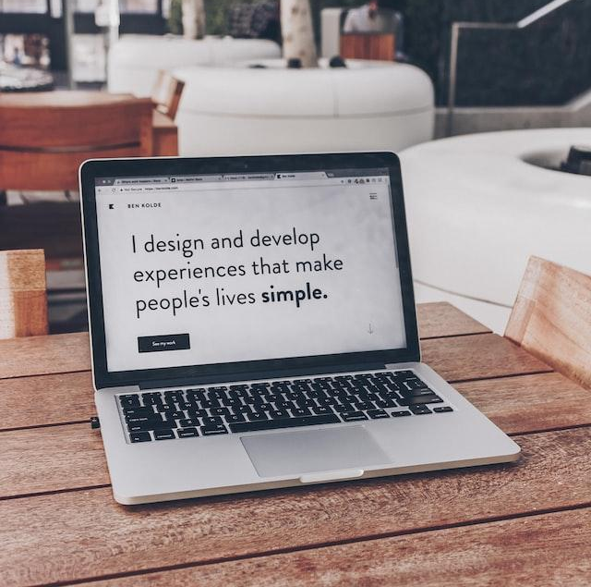
Day 1: Create Your First Website!
Introduction
Notes:
Photo by Ben Kolde on Unsplash

Slide 2

Your 6-Day Success Plan
You have done this!
Day 0 (30 mins):
Roadmap to Software Dev
Learn the pros of being software dev
Learn the step by step to be software dev

Slide 3

Your 6-Day Success Plan
We are currently here
Day 1 (1h):
Learn creating a website using HTML
Create Your First Website
Understand how websites understand HTML
Use HTML to create links & texts
Build a resume website

Slide 4
Your 6-Day Success Plan
Day 2 (1h):
Learn to style a website using CSS
Styling Websites
Add your profile picture for employers!
Learn to create buttons and design them
Build a Link in Bio project

Slide 5
Your 6-Day Success Plan
Day 3 (1h):
Learn data types such as numbers & strings
Build Interactive Website
Understand how to store data in variables
Learn how to show data
Create BMI calculator

Slide 6
Your 6-Day Success Plan
Day 4 (1h):
Learn to get user inputs
Better BMI
Understand how to make website interactive
Create better BMI calculator

Slide 7
Your 6-Day Success Plan
Day 5 (1h):
Learn how to create a list of quotes
Random Quote Generator
Show the quotes randomly
Create random quote generator

Slide 8
Your 6-Day Success Plan
Day 6 (1h):
Learn how to know if answer is correct
Quiz App
Show if the user got it right or not
Create quiz app

Slide 9
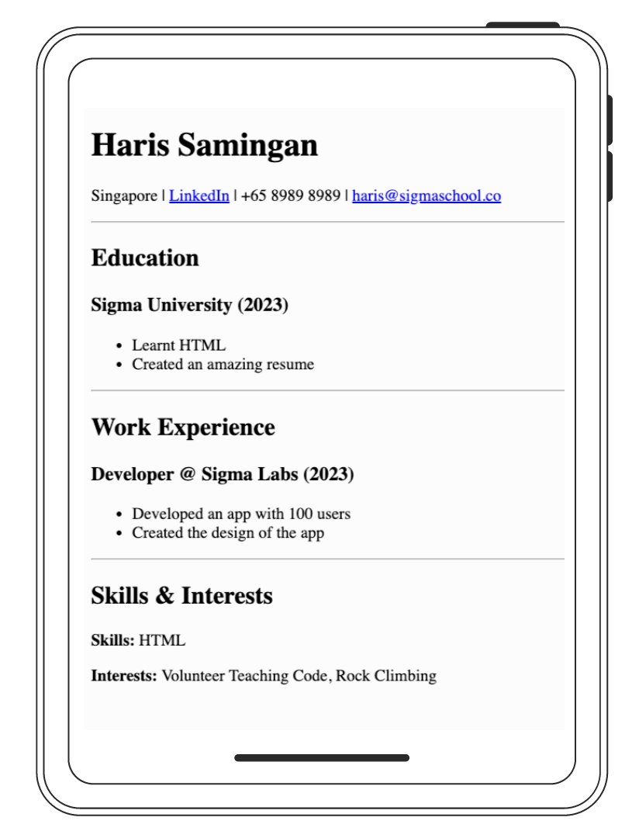
What your are building
It is a simple resume website to get you started to get a software developer job.
What you are learning:
- How to build a resume website using HTML
- Building a website in Replit
- Create a backup in GitHub
- Push your resume website live!
Demo resume here.
Day 1

Slide 10
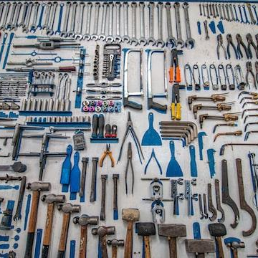
Tools required
We are using a website to code called replit.com
Replit is a website that helps to write code, build websites and take your website live (to share)!
No downloads required.
Let’s get started!
Day 1
Notes:
Photo by Cesar Carlevarino Aragon on Unsplash

Slide 11
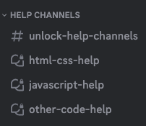
Need help?
We are happy to help with any issues, things you don’t understand in our Discord channel here.
Here is our full link:
https://discord.gg/yCrB7tfbhg
Once in discord, add your questions in our help channels.
Day 1

Slide 12
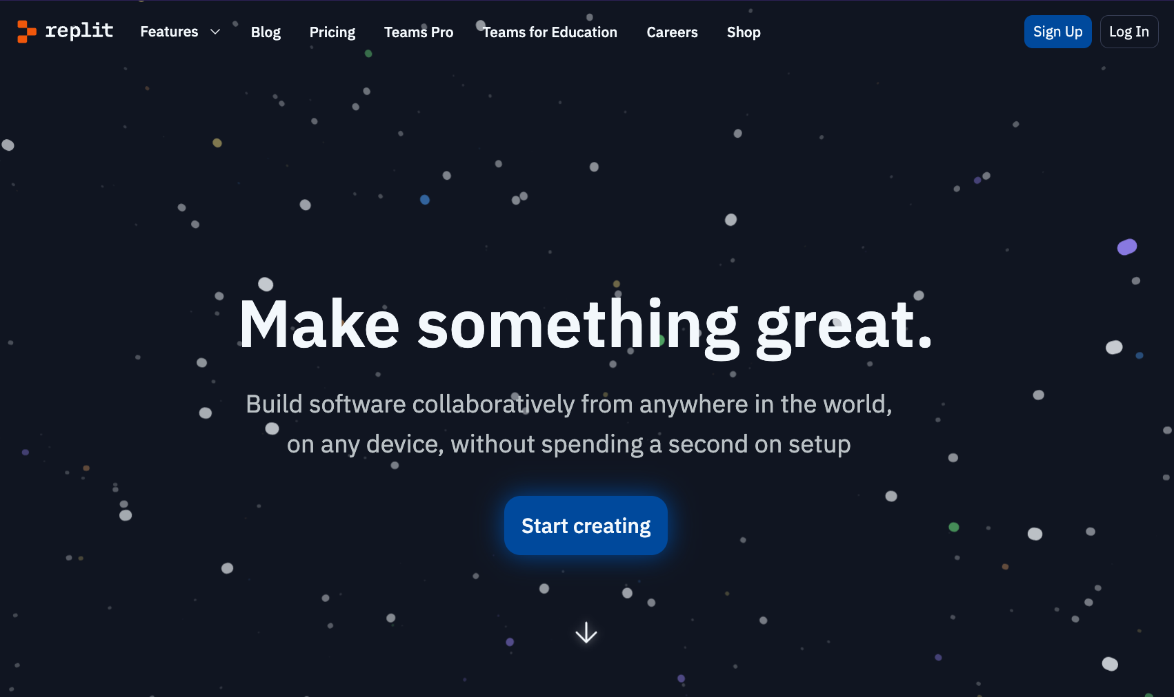

Go to replit.com and sign up

Slide 13
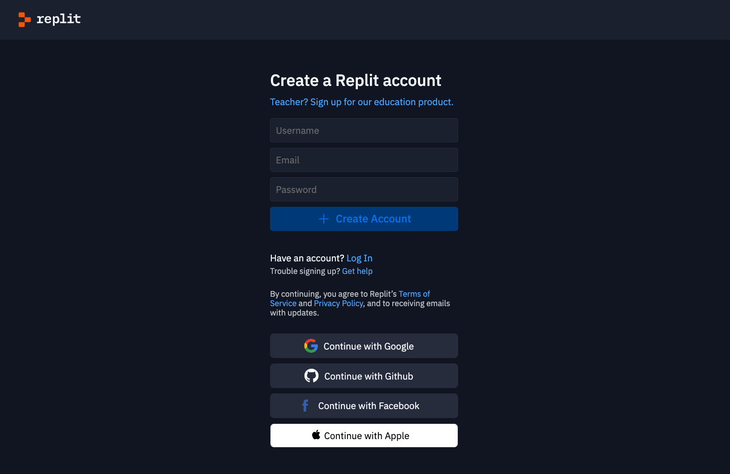
You can sign up with email & password or Google, Github, Facebook or Apple

Slide 14
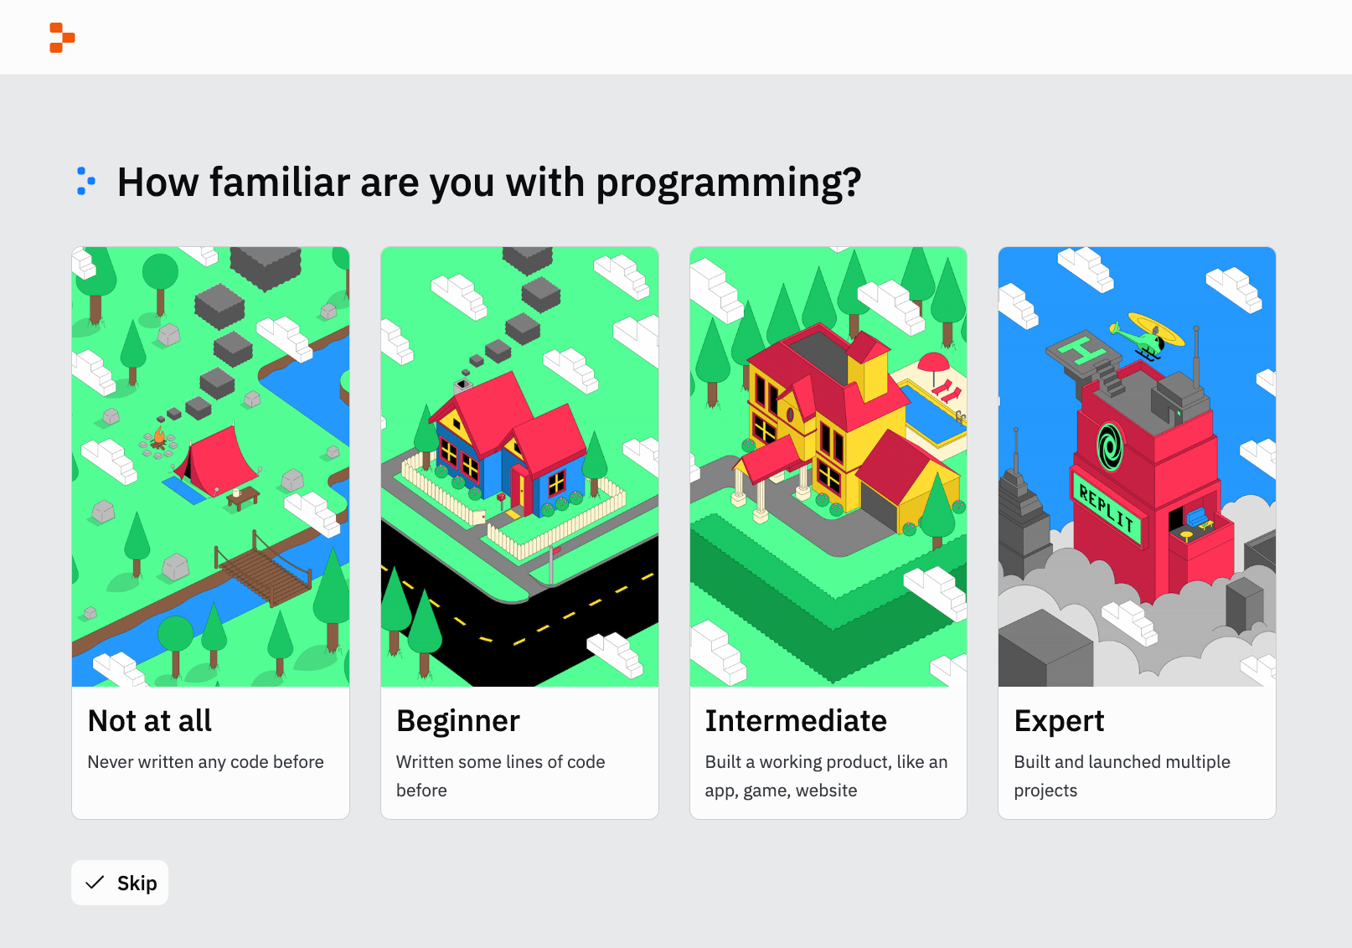
You will be brought here after successful login. Recommend to skip.

Slide 15
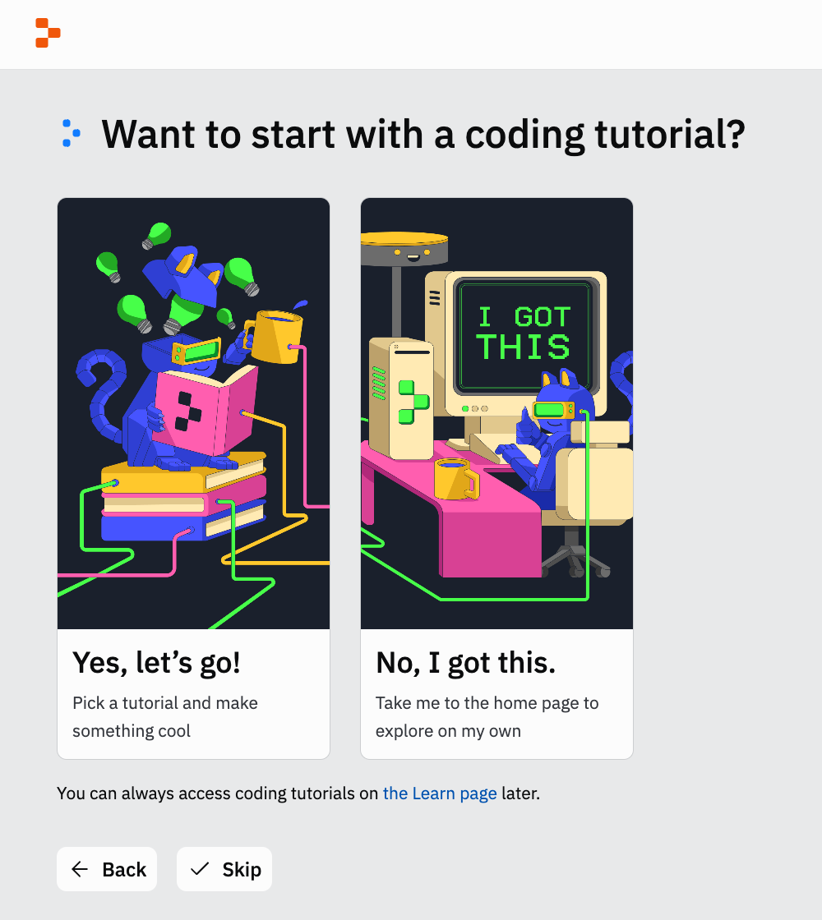
You will be brought here. Recommend to skip.

Slide 16
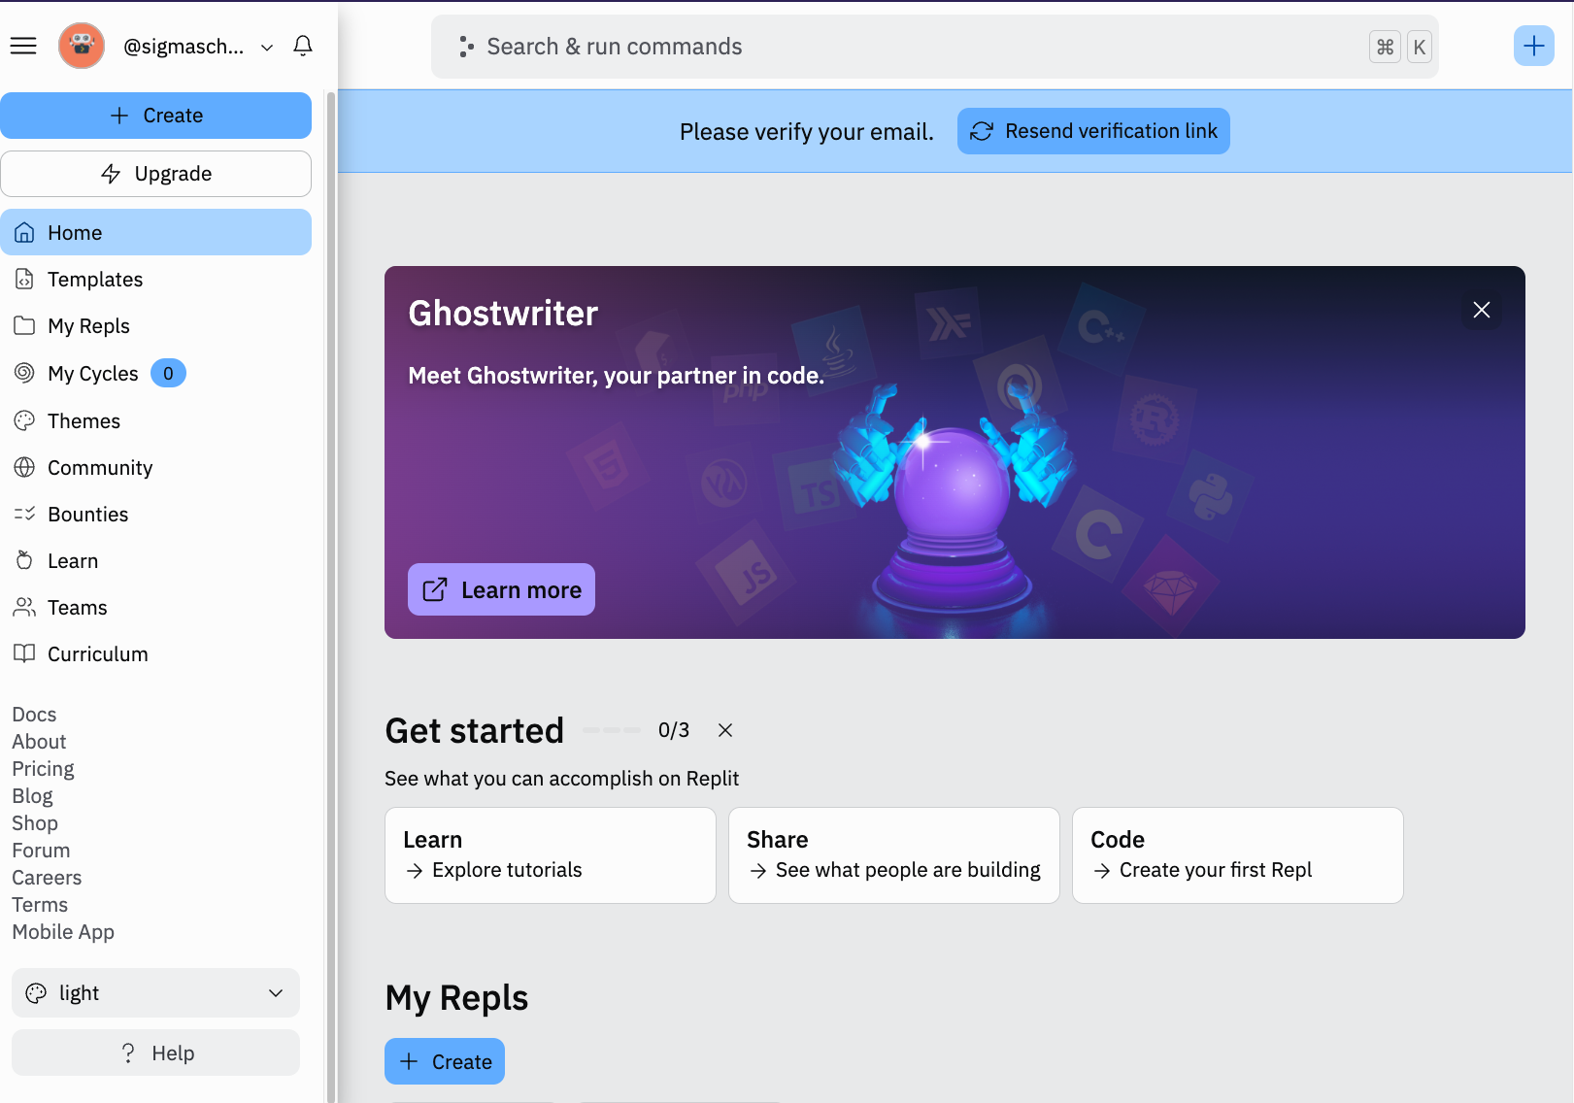
You can verify your email. Check your email inbox or spam folder.

Slide 17
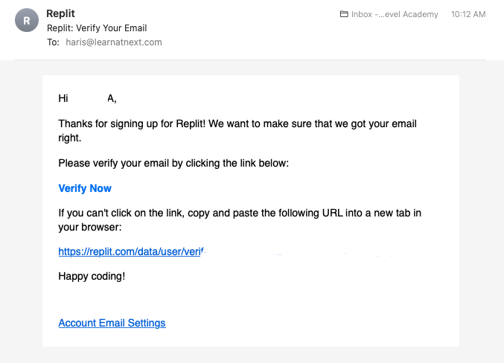
Click on the link in the email to verify.

Slide 18
You will be brought to the dashboard. Let’s create a new repl project! Click on the create button.

Slide 19
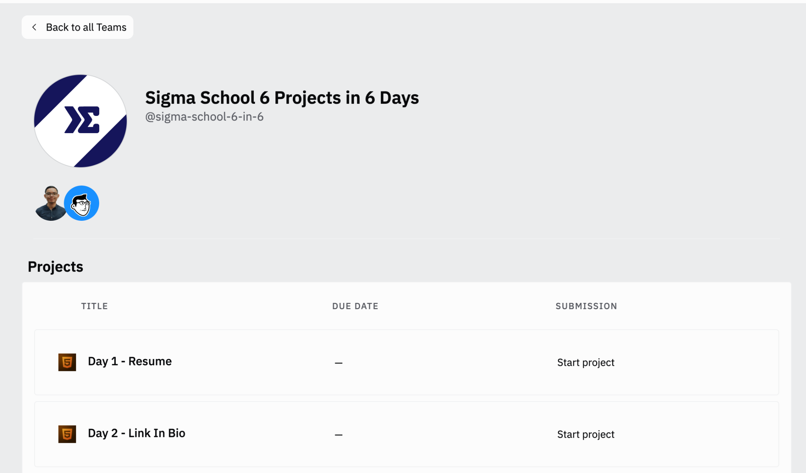
You can join our replit team here: https://sig1.co/replit-6in6
It should look like this:

Slide 20
You can click on Day 1 - Resume:

Slide 21
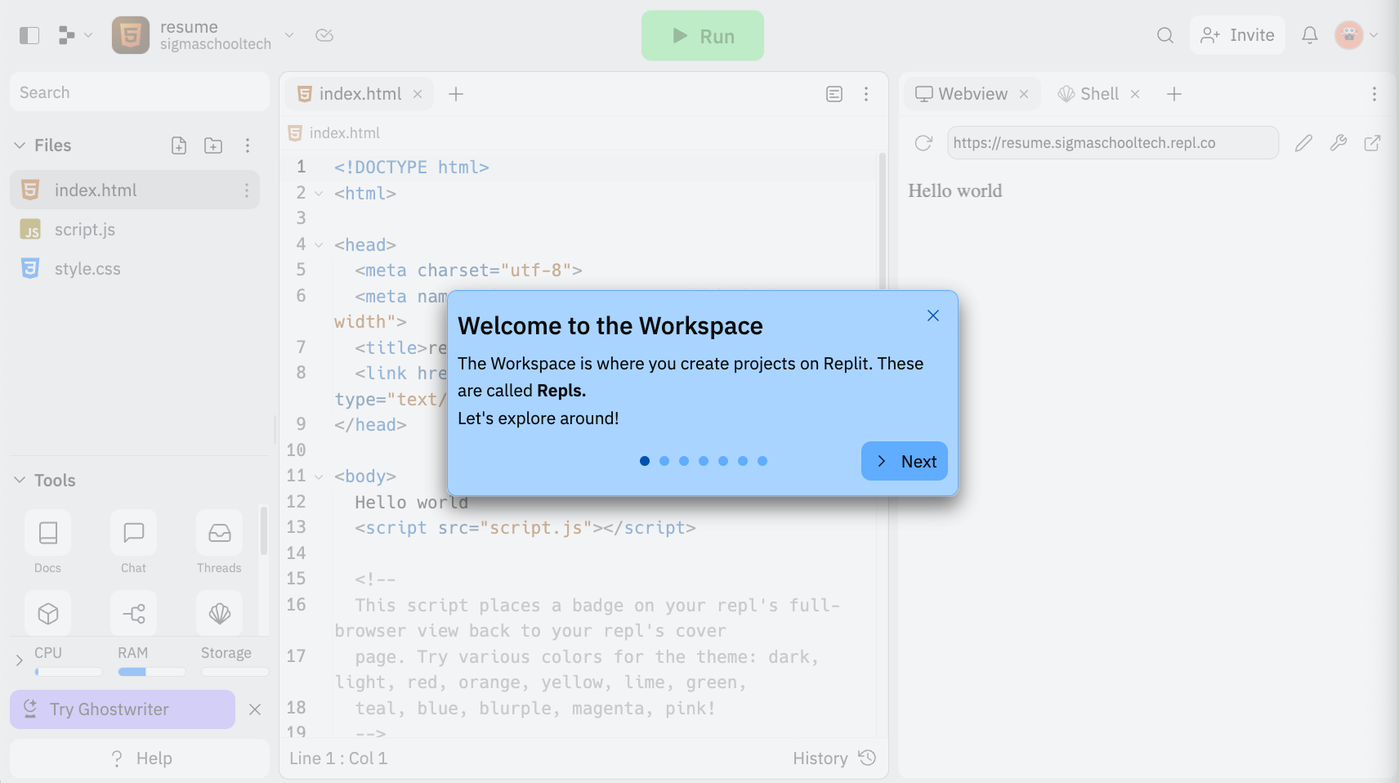
You will be brought to the Workspace. Let’s click on next to get a tour of the Workspace.

Slide 22
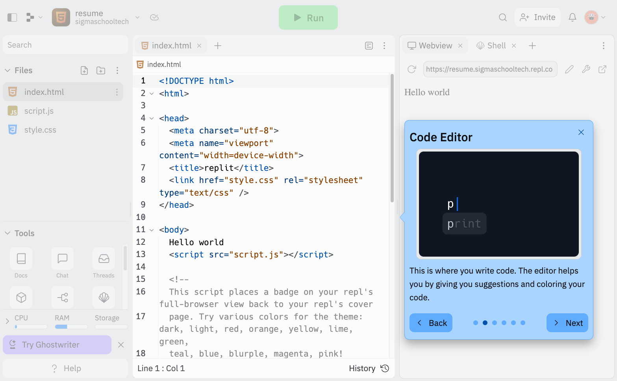
This is the Code Editor, where you write code (in red box). Let’s move on by clicking on Next.

Slide 23
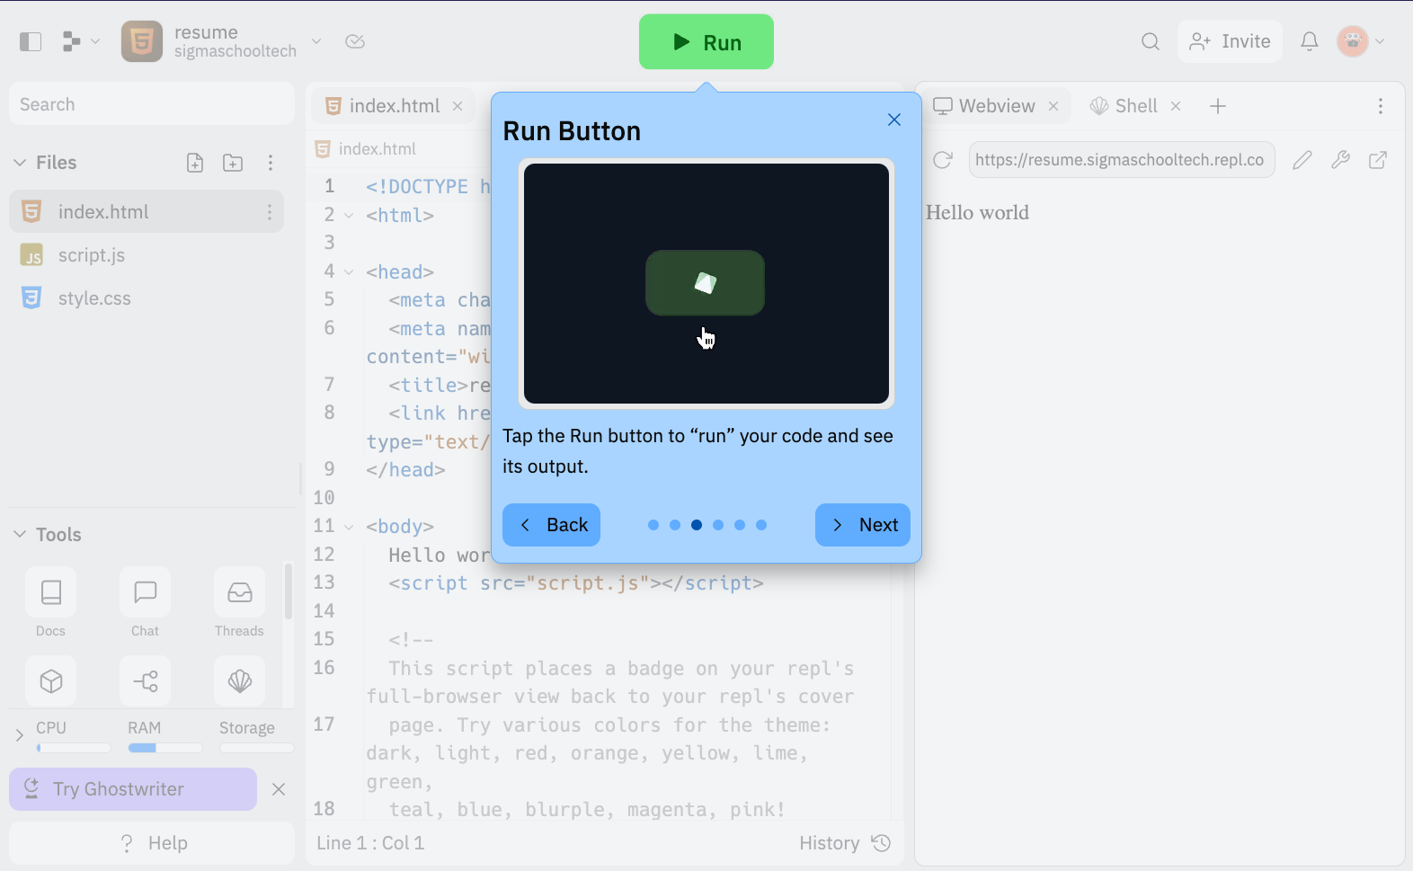
To see what your code does (or the output), click on the Run button. Next!

Slide 24
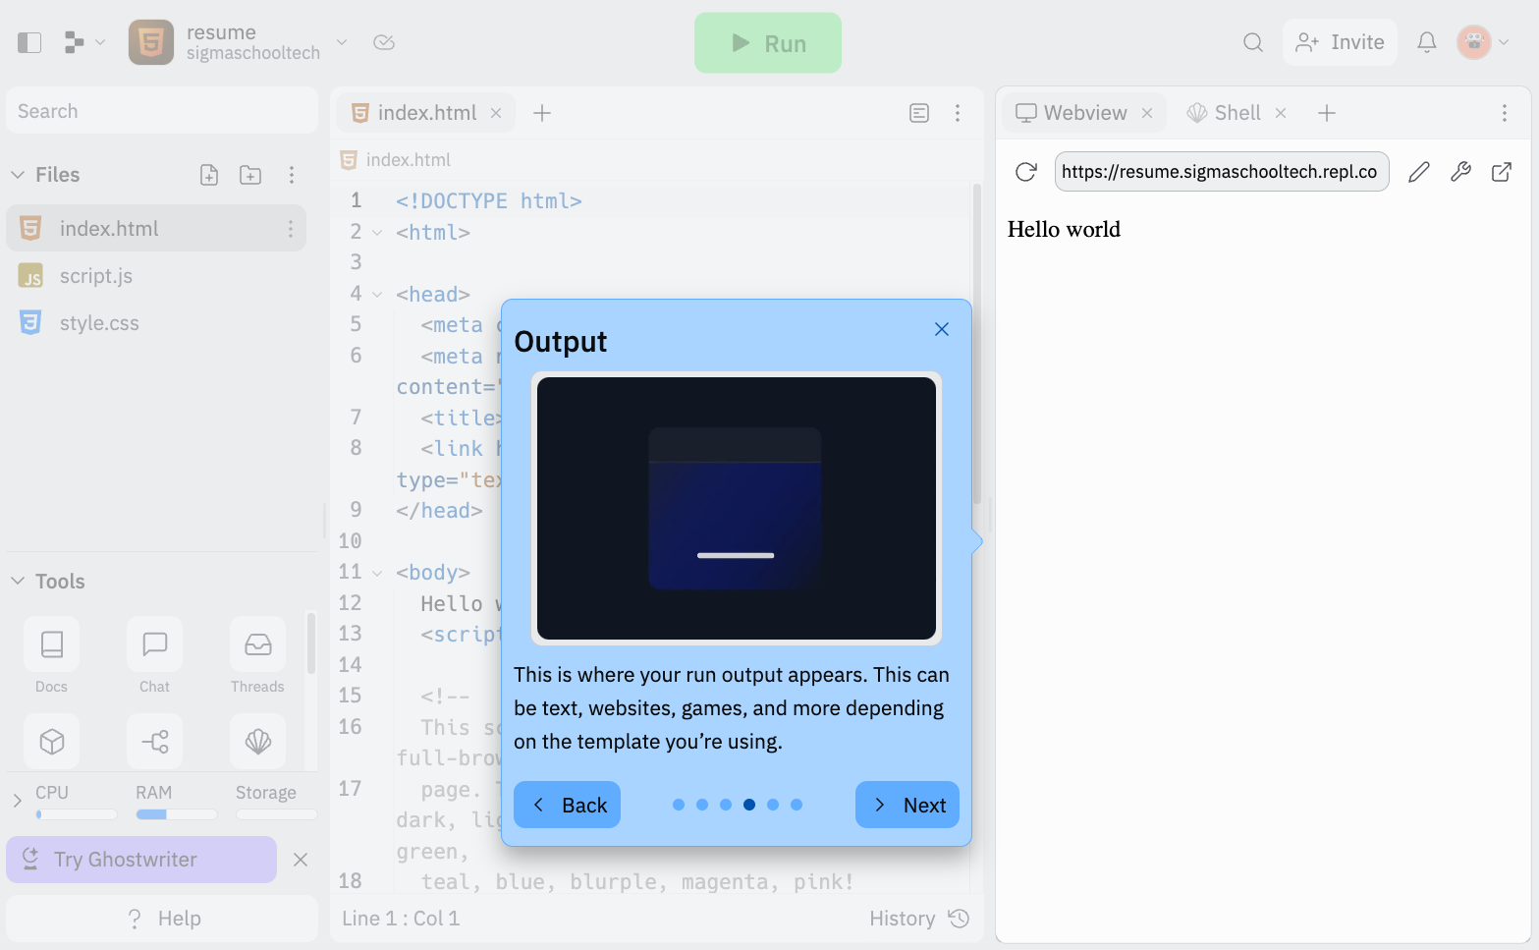
This is where how your website looks like. Next!

Slide 25
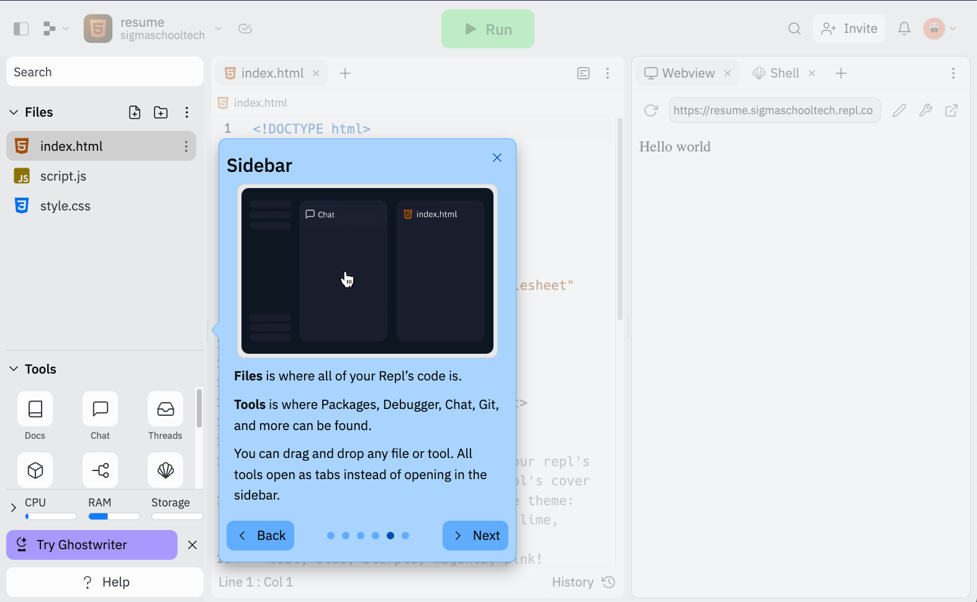
On the left is the Sidebar where your files/folders and tools lives. Next!

Slide 26
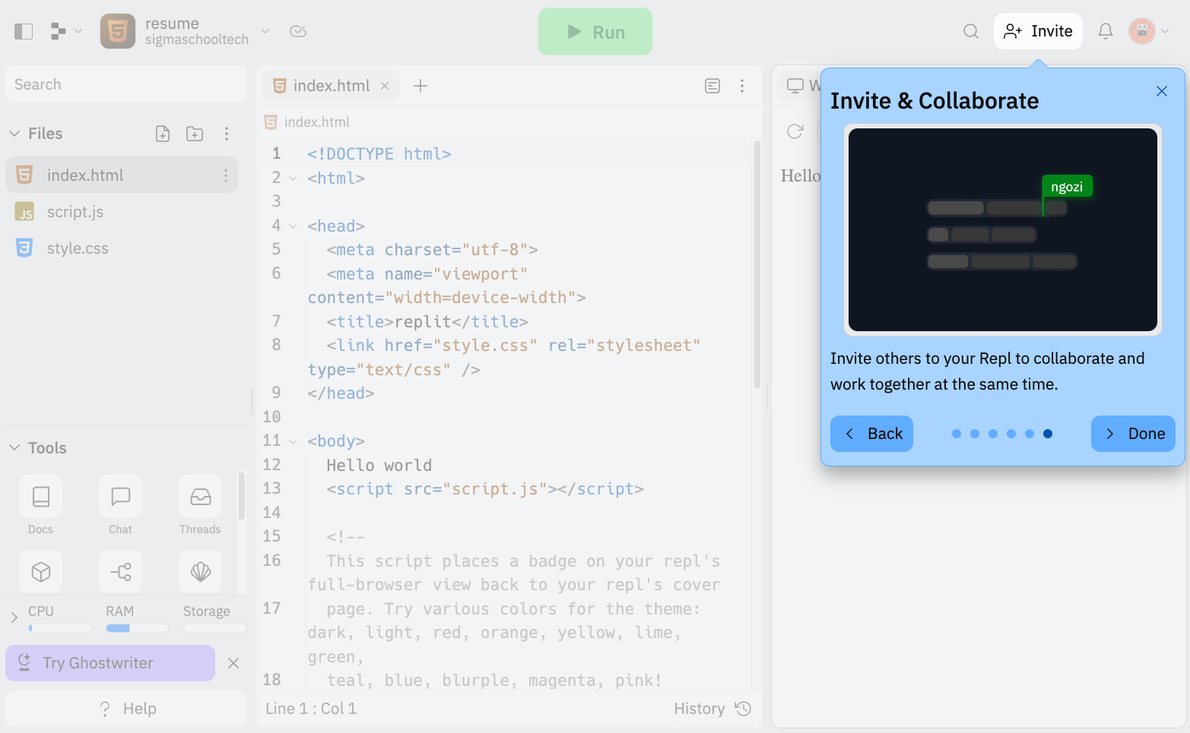
Want to have your friends to contribute your project? The Invite button does that. Done!

Slide 27
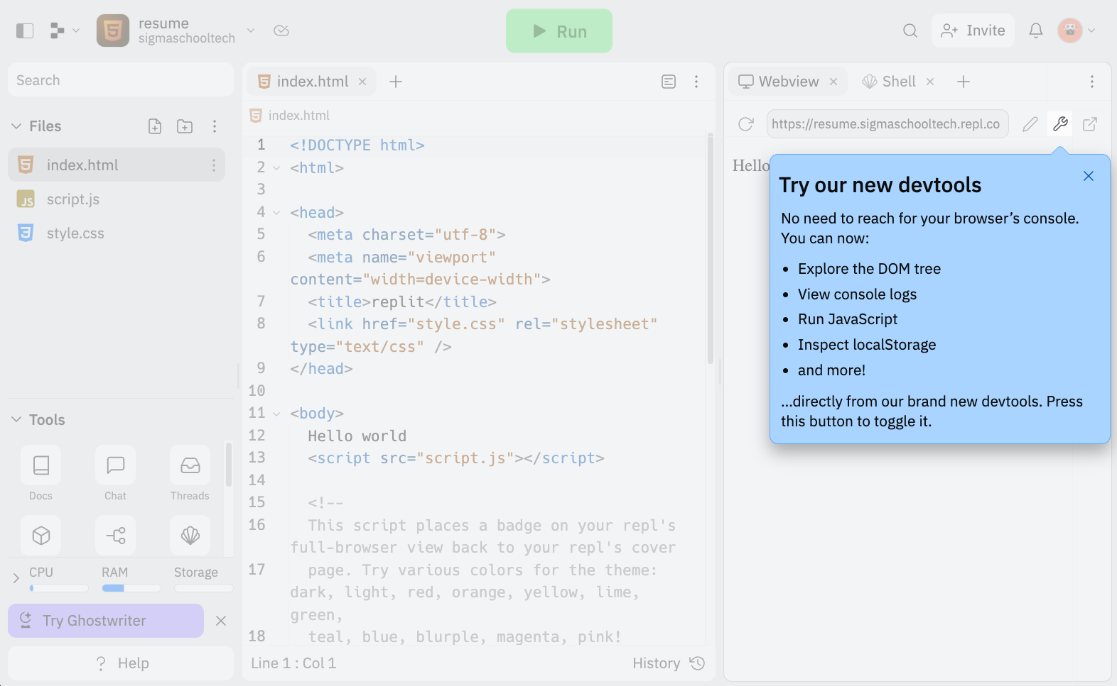
We will use devtools later on. This helps to resolve issues. Let’s get started building our resume!

Slide 28
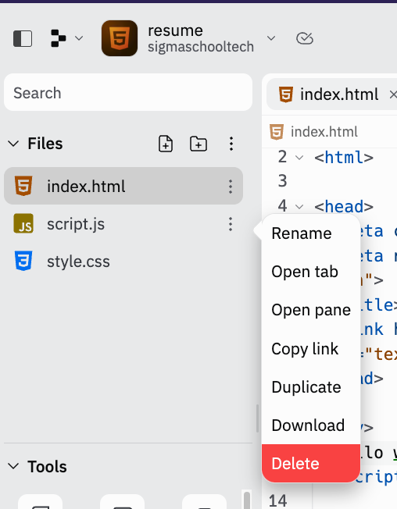
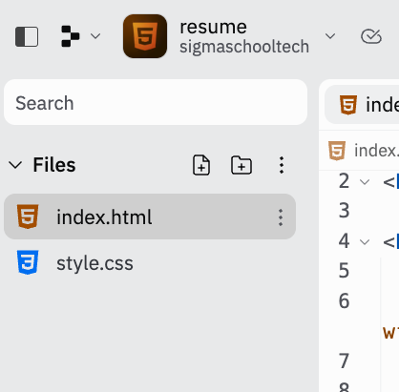
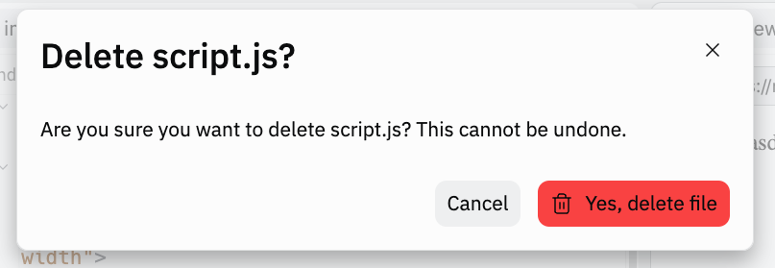
First, let’s delete the script.js. Why? We want to focus on learning HTML. JS will be taught in Day 3!
1
There should be no script.js!
2
3

Slide 29
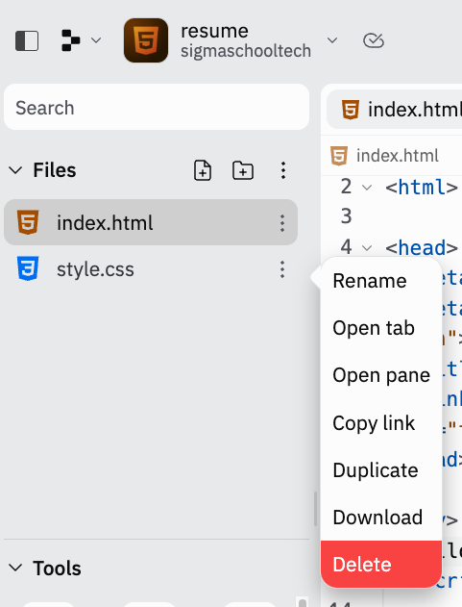
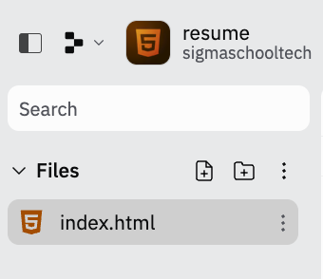
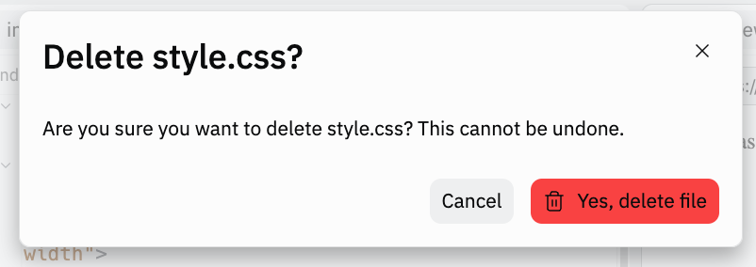
Let’s delete the style.css. Why? We want to focus on learning HTML. CSS will be taught in Day 2!
1
There should be no style.css !
2
3

Slide 30
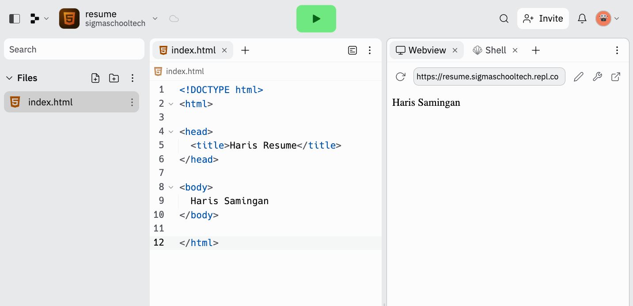
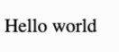
In the index.html, we are going to change the code here.
Before:
Notes:
<!DOCTYPE html> <html>
<head>
</head>
<title>Haris Resume</title>
<body>
</body>
Haris Samingan
</html>

Slide 31
After:
Change Haris & Haris Samingan to your name!
Notes:
<!DOCTYPE html> <html>
<head>
</head>
<title>Haris Resume</title>
<body>
</body>
Haris Samingan
</html>

Slide 32
Now, we are going to run this code to see our changes! To run, we click on the Green Play button.
Notes:
<!DOCTYPE html> <html>
<head>
</head>
<title>Haris Resume</title>
<body>
</body>
Haris Samingan
</html>

Slide 33
With a blink of an eye, you see that the Hello World changes to Haris Samingan (or your name)!
Notes:
<!DOCTYPE html> <html>
<head>
</head>
<title>Haris Resume</title>
<body>
</body>
Haris Samingan
</html>

Slide 34

Now, let’s check on our website in a new tab.
Click on the icon.
Notes:
<!DOCTYPE html> <html>
<head>
</head>
<title>Haris Resume</title>
<body>
</body>
Haris Samingan
</html>

Slide 35
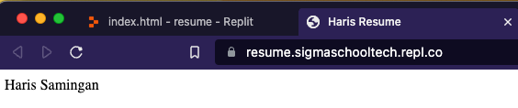
This should open another tab with the title of your name e.g. Haris Resume
Congrats on creating your first live website!
Take a break and I’m going to explain to you what you did.

Slide 36
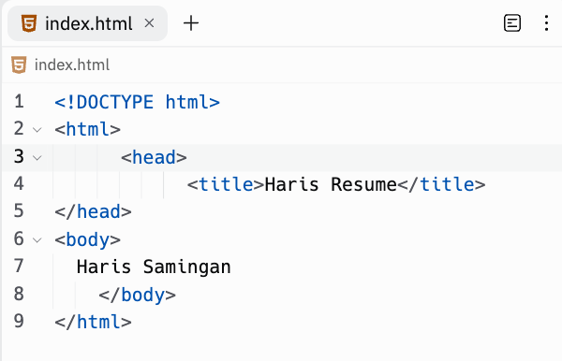
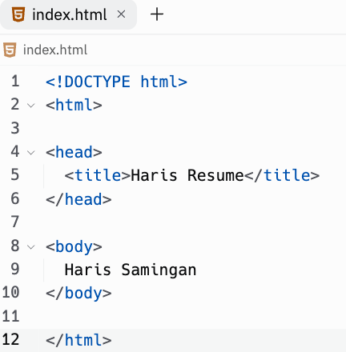
Is your code messy? You can arrange it nicely, automatically or reformat by clicking reformat button.
Before. Eeeww
After. Wow

Slide 37

Building blocks of websites:
HTML
Day 2
Notes:
Photo by La-Rel Easter on Unsplash

Slide 38

What is HTML?
HTML stands for Hyper Text Markup Language.
It is used to create and structure content for a website.
.html is the file type.
Why index.html? This is because index in web development is to refer to default or home page of website.
Let’s test if your paid attention!
Day 2
Notes:
Photo by Valery Sysoev on Unsplash

Slide 39
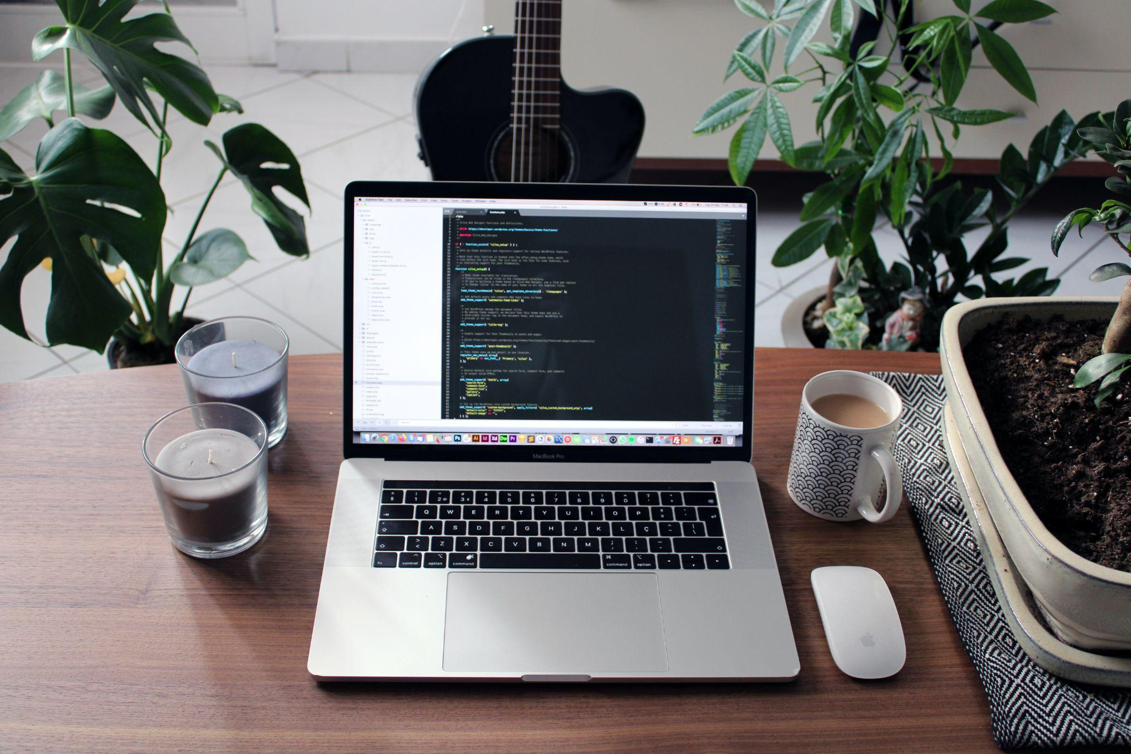
What is HTML?
Hyperlinks and Text Markup Language
Hypertext Markup Language
Hyperlinks Text Markup Language
Home Text Markup Language
Notes:
Photo by Nathan da Silva on Unsplash

Slide 40
What is HTML?
Hyperlinks and Text Markup Language
Hypertext Markup Language
Hyperlinks Text Markup Language
Home Text Markup Language
Notes:
Photo by Nathan da Silva on Unsplash

Slide 41

Why is it called index.html?
It is named after the index finger
Refer to the login page
Short for "indicate extension"
Refer to the default or home page
Notes:
Photo by Goran Ivos on Unsplash

Slide 42
Why is it called index.html?
It is named after the index finger
Refer to the login page
Short for "indicate extension"
Refer to the default or home page
Notes:
Photo by Goran Ivos on Unsplash

Slide 43

How to write HTML?
We use HTML tags. For example, we want to create a paragraph of text. This is how we do it:
<p> This is a paragraph of text.</p>
Explanation
<p> </p> : This is a paragraph tag.
<p>: opening paragraph tag
</p>: closing paragraph tag
<p> This is a paragraph of text.</p> :
The text (highlighted) in between the tags is called content.
Day 2
Notes:
Photo by Niels Kehl on Unsplash

Slide 44

How do we create paragraph tag?
<p> </p>
<par></par>
<pg> </pg>
<para> </para>
Notes:
Photo by Finn Mund on Unsplash

Slide 45
How do we create paragraph tag?
<p> </p>
<par></par>
<pg> </pg>
<para> </para>
Notes:
Photo by Finn Mund on Unsplash

Slide 46
What do we call the text in between the paragraph tag?
<p> This is a paragraph of text.</p>
text
markup
content
tag
Notes:
Photo by Nathan da Silva on Unsplash

Slide 47
What do we call the text in between the paragraph tag?
<p> This is a paragraph of text.</p>
text
markup
content
tag
Notes:
Photo by Nathan da Silva on Unsplash

Slide 48
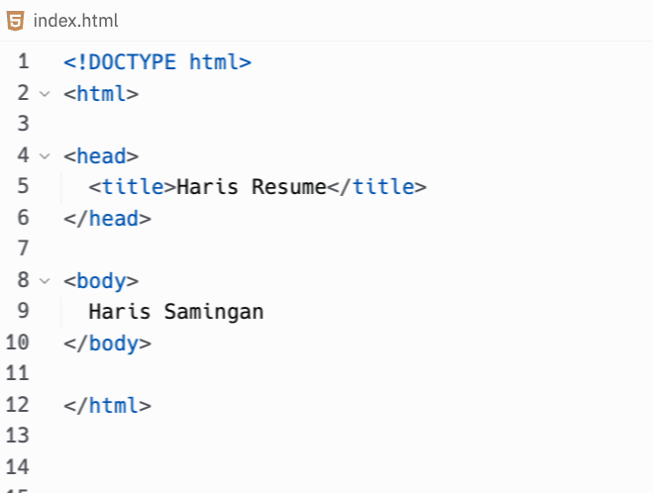
Starter code for website
Starter code or boilerplate code for any website will look like this.
This is the least amount of code for you to create a website.
Let’s get started in explaining all the different tags.
Day 2

Slide 49
HTML Tags
Starter code or boilerplate code for any website will look like this.
This is the least amount of code for you to create a website.
Let’s get started in explaining all the different tags.
Day 2

Slide 50
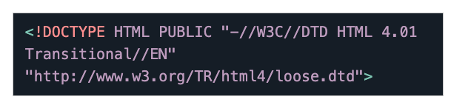
<!DOCTYPE html>
Currently, we are at HTML version 5. It is not a tag. Therefore, there is no closing tag. If you want to state previous version 4.01 of HTML, it would look like this:
Day 2

Slide 51
<html>
This tag is the container for all the other HTML tags on the page and indicates the start of the HTML document.
Day 2

Slide 52
<head>
This tag contains the metadata of the web page, such as the title, keywords, and links to CSS and JavaScript files.
Day 2

Slide 53
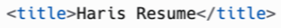
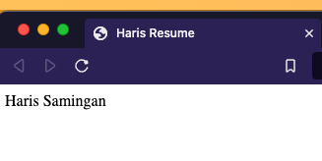
<title>
This tag is used to specify the title of the web page, which is displayed in the browser's title bar.
It is also used as the page's title when it is bookmarked or shared on social media.
Day 2

Slide 54
<body>
This tag contains the visible content of the web page, such as text, images, and other elements, that the user will see when they view the web page in a web browser.
Let’s make our name to a heading.
Day 2

Slide 55
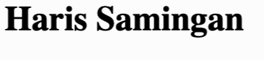
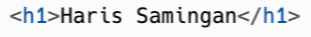
In the next step, let’s update the code¹ in the index.html to this, and run the code². This should make your name bold and big³.
Change Haris & Haris Samingan to your name!
2
3
1

Slide 56
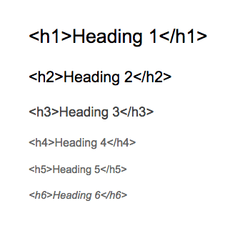
Headings
HTML heading tags are used to define the headings and subheadings of a web page.
<h1> tag indicating the main heading.
<h2> tag for subheadings.
<h3> to <h6> tags for sub-subheadings.
They provide a structure and hierarchy to the content, enhancing the accessibility and usability of the web page.
Let’s use this headings for our resume!
Day 1

Slide 57
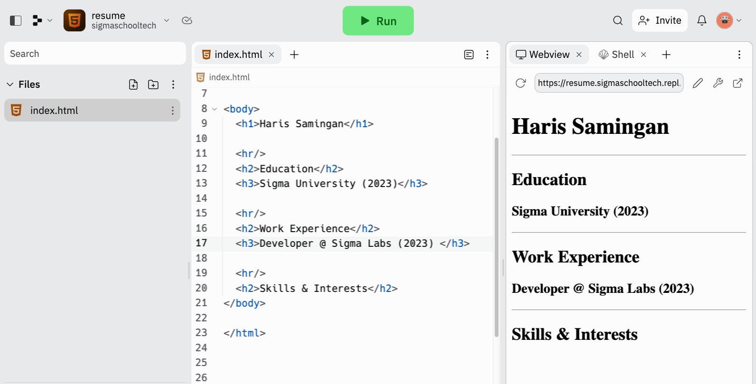
In the index.html, update the code¹ to this, and run the code². It should look like this³.
Change your education and work experience to yours
2
3
1

Slide 58
<hr>
Please don’t report to the hr department of me stealing pens.
I mean, hr tag is used to insert a horizontal rule or line into a web page. This is show a separation of sections like your name and education.
Now let’s add our descriptions for our education, experience, skills and interests!
Day 1
Don’t delete any code. This is just explanation.

Slide 59
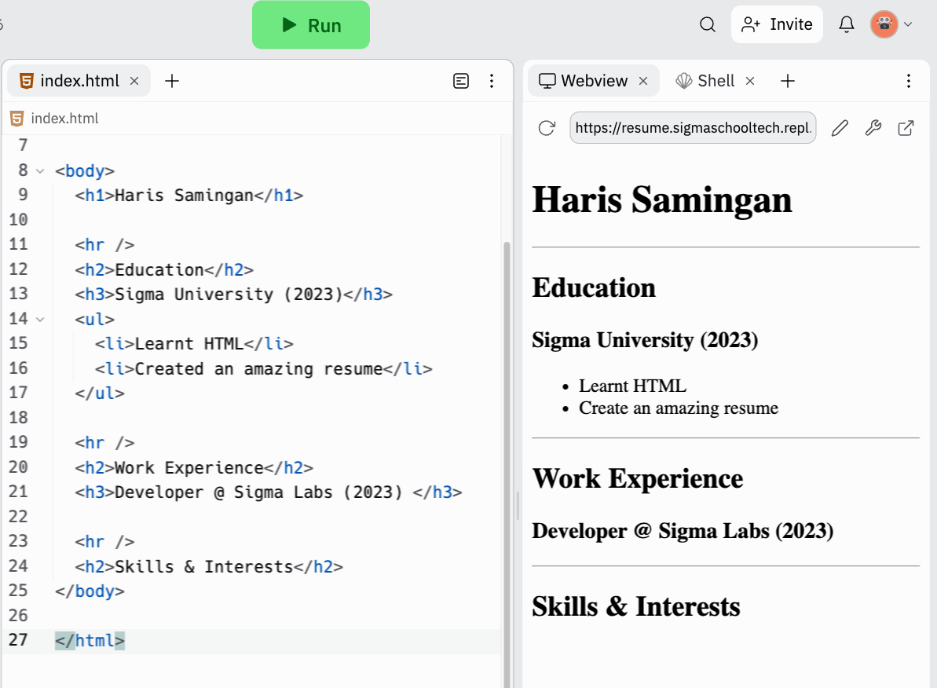
In the index.html, update the code¹ to this, and run the code². It should look like this³.
Change your description education to yours. Is Sigma University happening? Maybe 👀
2
1
3

Slide 60
Lists
The <ul> and <li> tags are used to create an unordered list (or point forms) of items on a web page.
The <ul> tag defines the container for the list, and the <li> tag defines each individual item in the list.
Day 1
Don’t delete any code. This is just explanation.

Slide 61
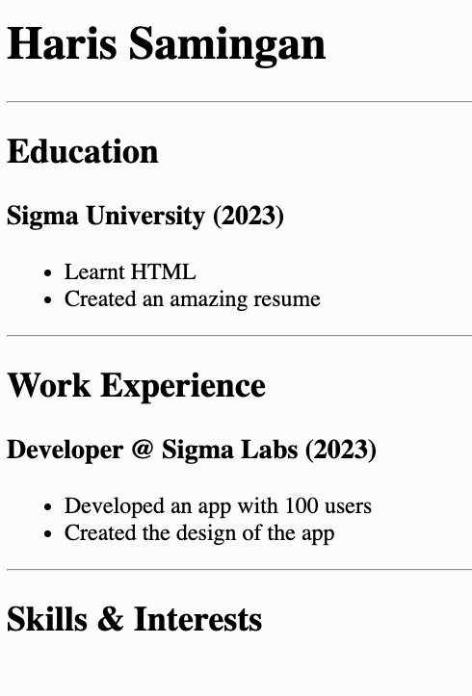
Task
Create a list of descriptions for your work experience. You can put your own work experience or follow the example.
It should look something like this:
Once done, let’s add our skills and interests!
Day 1
Example

Slide 62
In the next & future slides…
We will be showing part of the code instead of the full code. We call this Code Parts.
In this example, we want to add Haris resume in the title tag.
You might be thinking, how about showing the rest of the code?
Day 1
Example of Code Parts

Slide 63
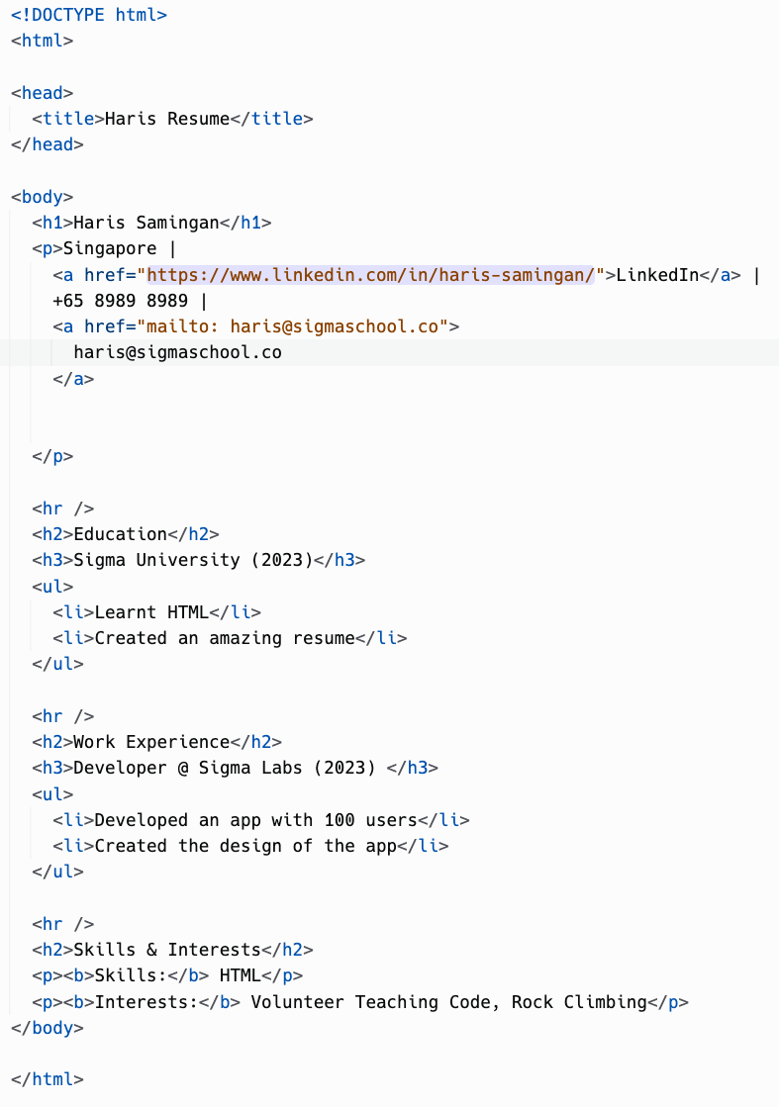
If we show the full code…
The code & text will be too small for you to refer. Just like Singapore, there isn’t enough space.
Therefore, in the next slide, we will go through how to read and add code parts in your project.
Day 1
Full code

Slide 64

How to read, understand and add Code Parts in your project?

Slide 65
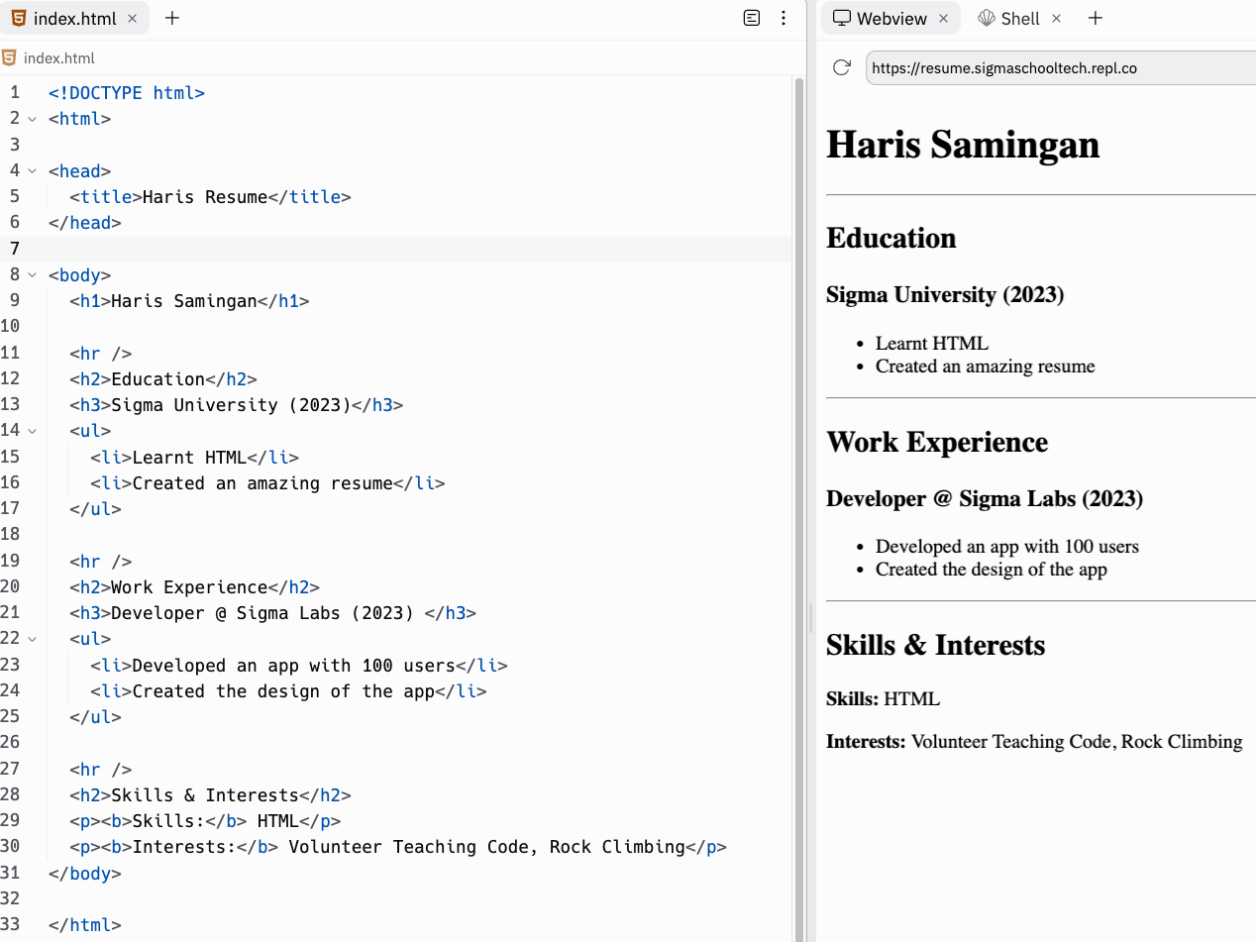
In the index.html, update the code¹ to this, and run the code. It should look like this².
Change your skills & interests to yours
Don’t delete code before hand. Find this block of code and add the code in the red box. Watch video in previous slide if unclear
1
2

Slide 66
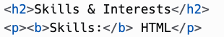
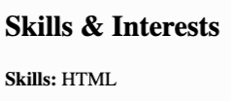
Paragraph & bold
The <p> tag is used to create a paragraph of text (or sentences)
The <b> tag is used to make text bold.
Lastly, we are going to links for tech recruiters and employers to reach to you!
Day 1
Don’t delete any code. This is just explanation.

Slide 67
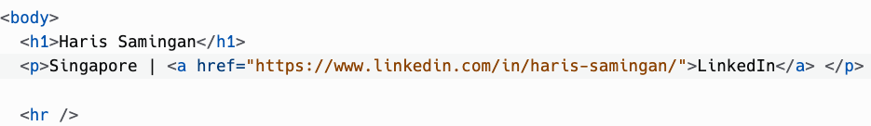
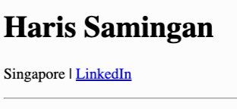
In the index.html, update the code¹ to this, and run the code. It should look like this².
Change to your location & LinkedIn profile url
Don’t delete any code. Find this block of code and add the code in the red box.
1
2

Slide 68
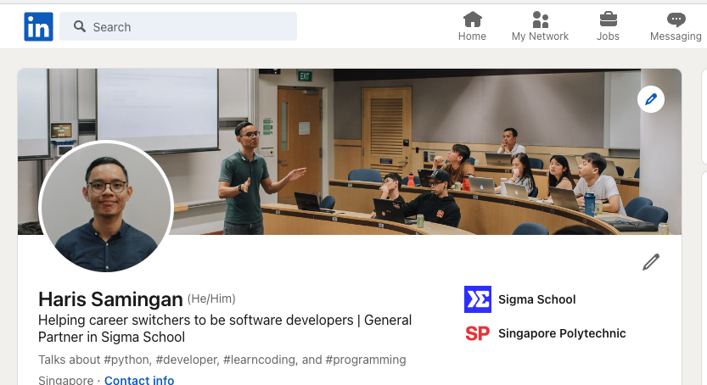
Test it out by clicking on the link. It should go to your LinkedIn profile.

Slide 69
Anchor tag
The <a> tag or anchor tag, is used to create links to other websites.
The <a> tag requires a href attribute.
Attributes used to provide extra information to a HTML element, such as the url for a link.
href is short for hypertext reference, which is another word for url.
Day 1

Slide 70
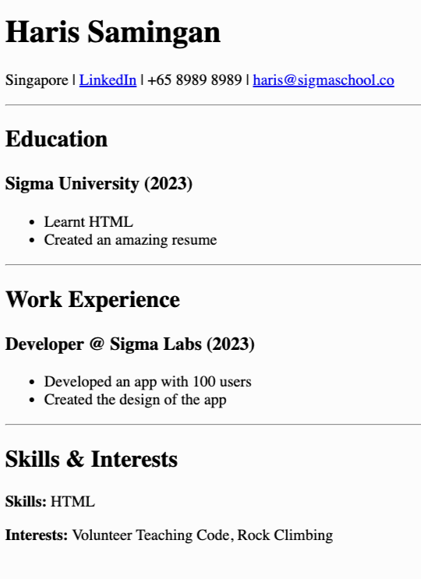
Tasks
1. Add your phone number (Easy)
2. Email address (Easy)
3. When click on email address, it opens the email application (Hard) . Click here for hint.
It should look something like this
Try your own and check your answer in next slide!
Day 1

Slide 71
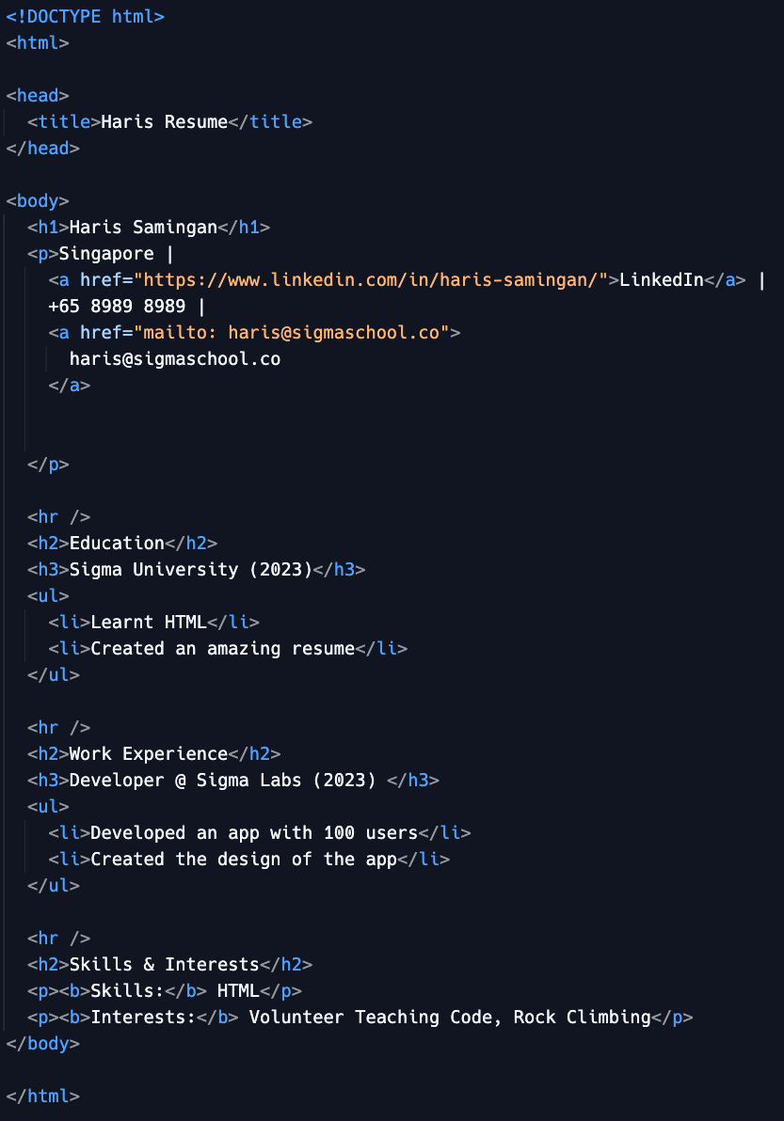
Answer
Full code here:
https://replit.com/@sigmaschooltech/resume1#index.html

Slide 72

Push your resume website live!
Day 1
Notes:
Photo by João Ferrão on Unsplash

Slide 73
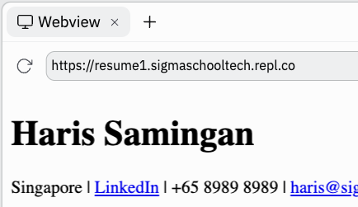
Push website live!
The best part about replit is that your web project is already live.
The link for your project is inside your webview.
Day 1

Slide 74


Congratulations!
You have created your first website!
Share your first website in our Discord channel here.
More specifically under the Share Your Achievements section > #i-built-this channel.
Day 1

Slide 75

Extensions!
This is where you can add more for your current resume project.
Since we want you build a killer resume to get you a software developer job, here is a video to improve your resume!
Day 1
How To Write a Resume with No Job Experience

Slide 76

Gain points!
Now that you have completed this module, you can gain points by doing this survey:
https://forms.gle/FJzRxgVw7fS2DMPY9
You can gain up to 16 points!
Currently, you can get a free Sigma T-shirt for 150 points.
There will be more freebies in the future ~
Not real. Picture is for illustration purposes.

Slide 77
Full code here:
https://replit.com/@sigmaschooltech/resume1#index.html

Slide 78
Day 1 completed!

